Slide 1

The Fellowship of the Star Schema Transforming OLTP Data for PBI
Kristyna Ferris
Please grab some swag!

Slide 2

About Me ~ Kristyna Ferris
Microsoft MVP, Data Platform & Fabric Solution Architect, P3 Adaptive Lexington Data Tech Group co-organizer Co-author on DataOnWheels
Blog - https://dataonwheels.wordpress.com/ LinkedIn - https://www.linkedin.com/in/kristyna-ferris-dataonwheels/
Twitter & Bluesky - @data_dragoness

Slide 3

A Quiet Start in the Shire - OLTP Origins
Many separate, highly specialized tables.
Day-to-day operations
Used by front-line workers and applications
Goal is transaction speed
Real-time data refreshness
Examples: order entry, banking, POS

Slide 4
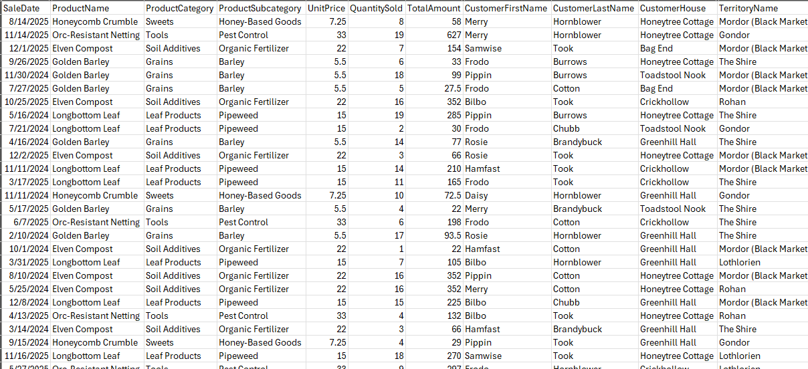
Sample OLTP

Slide 5
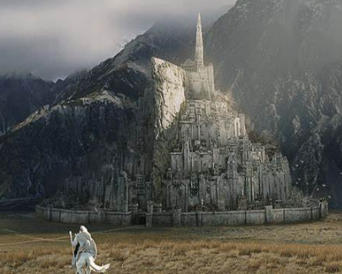
Arriving in Gondor – OLAP Citadel of Insight
Fewer, Organized Facts and Dimensions
Business analysis & reporting
Used by analysts, executives, & Power BI
Goal is query & aggregation speed
Data refreshed periodic (hourly/daily)
Examples: forecasting, sales analysis, reporting

Slide 6
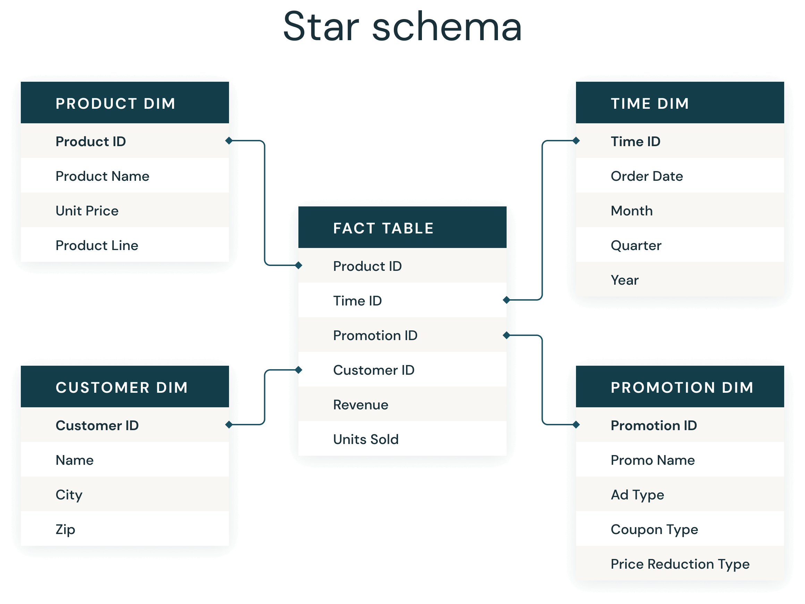
Sample OLAP

Slide 7
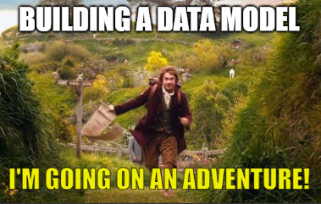
Journey to OLAP - Following the Star (Schema)
Star Schema is a proven table design for analytics.
Consists of a central fact table surrounded by related dimensions that slice and dice the facts
Fact tables = measurable data (sales, revenue, inventory, etc.)
Dimension tables = descriptive context (customer, product, date)
Optimized for Power BI and the Vertipaq engine
Supports powerful reporting scenarios like slicers, hierarchies, and time intelligence

Slide 8
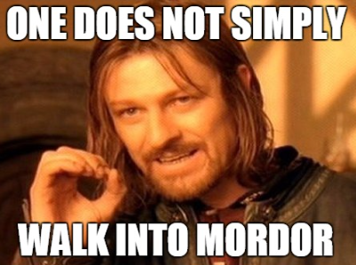
The Council of Stakeholders – Defining the Quest
Before the Fellowship can chart its path, we must seek counsel and uncover the true questions that guide our quest—for only by knowing what must be answered can the journey to insight begin.
Notes:
Pull out the bus matrix!

Slide 9
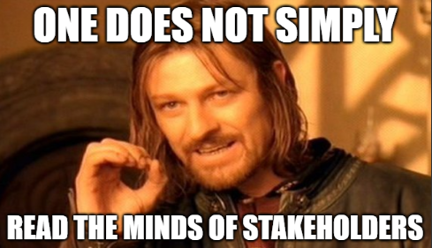
The Council of Stakeholders – Defining the Quest
What decisions are being made with this data?
What KPIs or metrics are most important to track?
What is the “make more money” question to answer?
What grain and scope of the data is needed?
Who will use this report and how do they need to slice this data?
What dimensions provide context for these metrics?
Where does the data currently live?
Are there data quality issues we need to resolve?
How frequently do we need to answer these questions?
Notes:
Pull out the bus matrix!

Slide 10
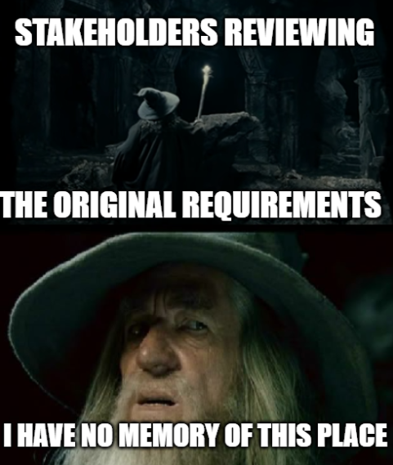
The Council of Stakeholders – Defining the Quest
Pro Tip:
Write the answers to these questions down and email them to stakeholders.
This will hold them accountable to what the original goal of the report was.
Even better, put the answers on a hidden page of the report so the purpose of the report can never be forgotten.
Notes:
Pull out the bus matrix!

Slide 11

Mapping the Star Schema – Bus Matrix
Focus on measurable, event-based processes.
This can easily result in the need for multiple reports and may highlight missing data.
Dimension → Business Process/Facts ↓ | Date | Product | Customer | Territory | Store
Sales
Inventory
Returns
Notes:
Benefits: Clarifies Scope: Stakeholders see what data is needed and where it overlaps.
Encourages Reuse: Promotes conformed dimensions—single definitions reused across processes.
Supports Iteration: You can build out your data warehouse in increments.
Bridges Tech & Business: Translates messy system tables into understandable business concepts.
Facilitates Power BI Modeling: Leads to semantic models that support consistent slicing/filtering.
Don’t be afraid to include data that doesn’t exist for now.

Slide 12
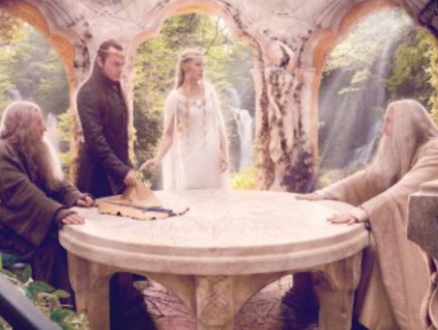
Guidance from the White Council - Best Practices
Create an integer key for dimensions if one does not exist.
A column should be exposed in the model once and only once (excluding keys)
Customer Name should only live in the customer dimension, and not in any of the fact tables. That’s why we have keys.
Columns should have unique and descriptive names
Name in both the Product and Customer dimensions is not helpful. Be specific.
Notes:
Part 1

Slide 13

Guidance from the White Council - Best Practices
Use friendly names for columns. Spaces are okay in Power BI!
If a column is not needed for the report, do not import it.
Each dimension should have one row per “something”
Nearly all relationships should be 1 (dim) to many (fact)
Don’t relate two fact tables to each other
Roche’s Maxim – transform your data as far upstream as possible and as downstream as necessary
Notes:
Part 2

Slide 14
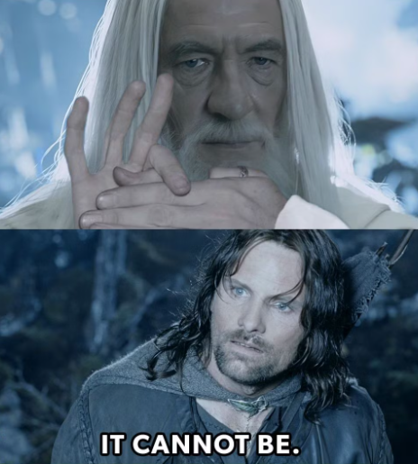
Demo Time!

Slide 15
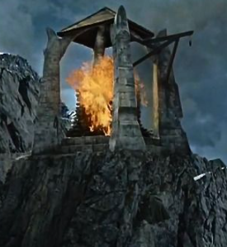
Light the Beacons – Additional Resources
Trusted Allies
Guy in a Cube
Kimball Group
Story BI training (hands-on course)
Pragmatic Works
Local user groups
Additional Topics to Explore
Slowly changing dimension type 2
Measures versus columns
Vertipaq engine optimization
Cardinality
Creating a date table
Notes:
Article & Design Tips at Kimball Group https://www.kimballgroup.com/category/articles-design-tips/ for free articles covering 20 years.
Dimensional Modeling in Fabric Warehouse (Microsoft Learn) https://learn.microsoft.com/en-us/fabric/data-warehouse/dimensional-modeling-overview
Why Power BI Loves a Star Schema: https://www.youtube.com/watch?v=vZndrBBPiQc
https://learn.microsoft.com/en-us/power-bi/guidance/star-schema

Slide 16

Don’t forget to connect, thanks for listening!
https://dataonwheels.wordpress.com/
kristyna@dataonwheels.com
@data_dragoness
GitHub

